Slide 1

PORTFOLIO CREATION
Showcasing Skills, Projects & Growth
Notes:
Introduce the session as a practical guide to building a professional portfolio that supports placements and career growth.

Slide 2
1
What is a Portfolio?
2
3
4
Virtual show of your competencies
5
6
Curated collection of work, skills & achievements
Dynamic extension of the resume
Demonstrates initiative & problem‑solving ability
7
8
9
Notes:
Explain that portfolios go beyond resumes by showing how students apply knowledge. Example: GitHub repos, ML models, UI/UX designs.

Slide 3
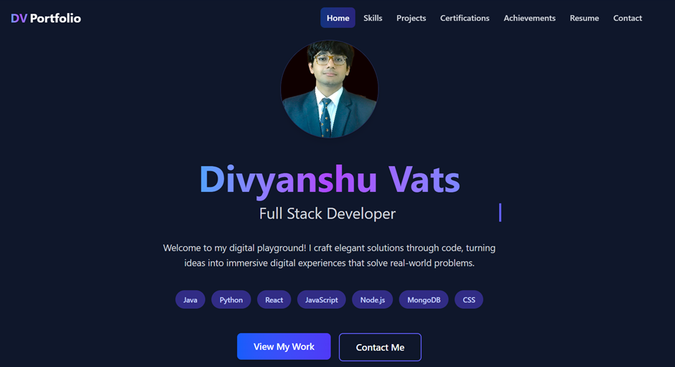

Slide 4



1
Importance of Portfolio Building
2
2
3
4
Builds credibility with recruiters
Highlights real‑world application of skills
Differentiates you from peers with similar resumes
Reflects continuous learning & growth
5
6
7
8
9

Slide 5

1
About Me
2
3
Brief personal intro
Academic background & career goals
Unique qualities or interests
4
5
6
7
8
9
Notes:
Encourage students to keep it concise yet personal. Example: “Passionate about AI & problem‑solving, aiming for product development roles.”

Slide 6
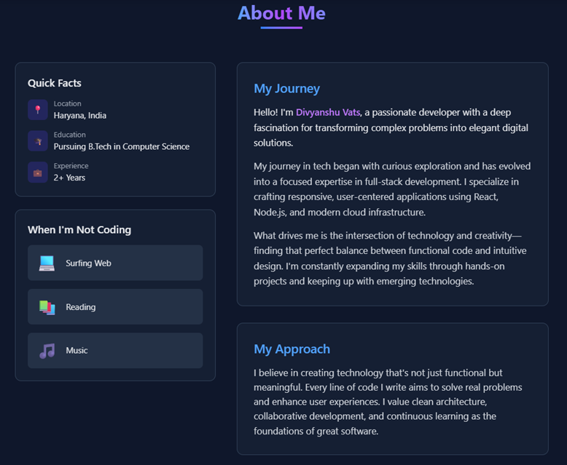

Slide 7
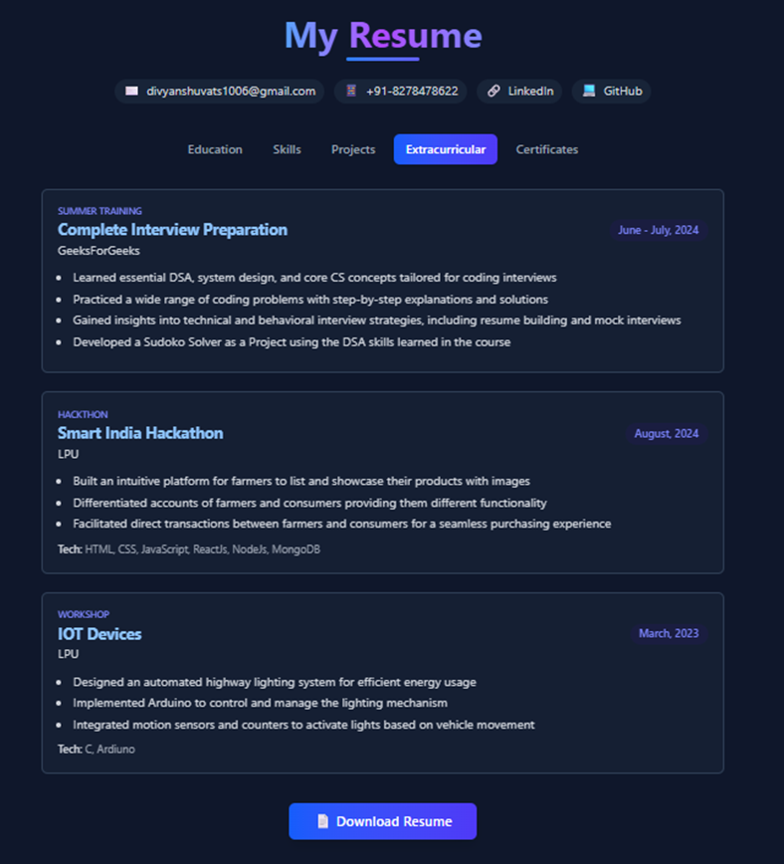
1
Resume
2
3
4
Ensure you add your resume
Contact details & career objective
Education, skills, internships
Tailored for tech industry roles
5
6
7
8
9
Notes:
Explain that embedding a resume in the portfolio ensures recruiters can quickly access it.
The resume acts as a snapshot for recruiters during shortlisting. A well-organized resume embedded in your portfolio ensures quick access and reinforces your readiness for interviews.

Slide 8
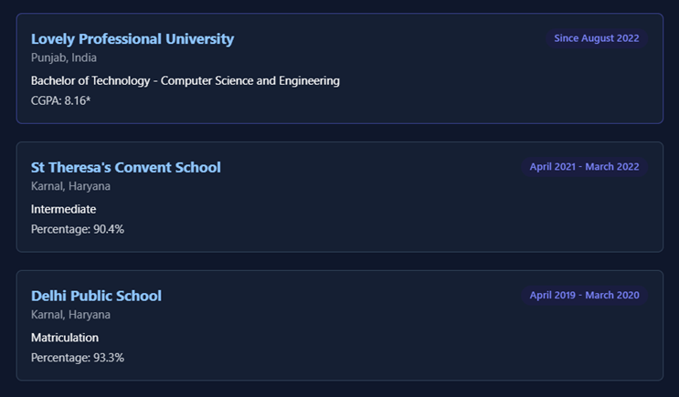
1
Education
2
3
4
Current B.Tech program details
Specialization & CGPA/percentage
Highlight relevant coursework & projects
Include details of previous education
5
6
7
8
9
Notes:
Highlight how coursework (e.g., Data Structures, ML) aligns with career goals.

Slide 9
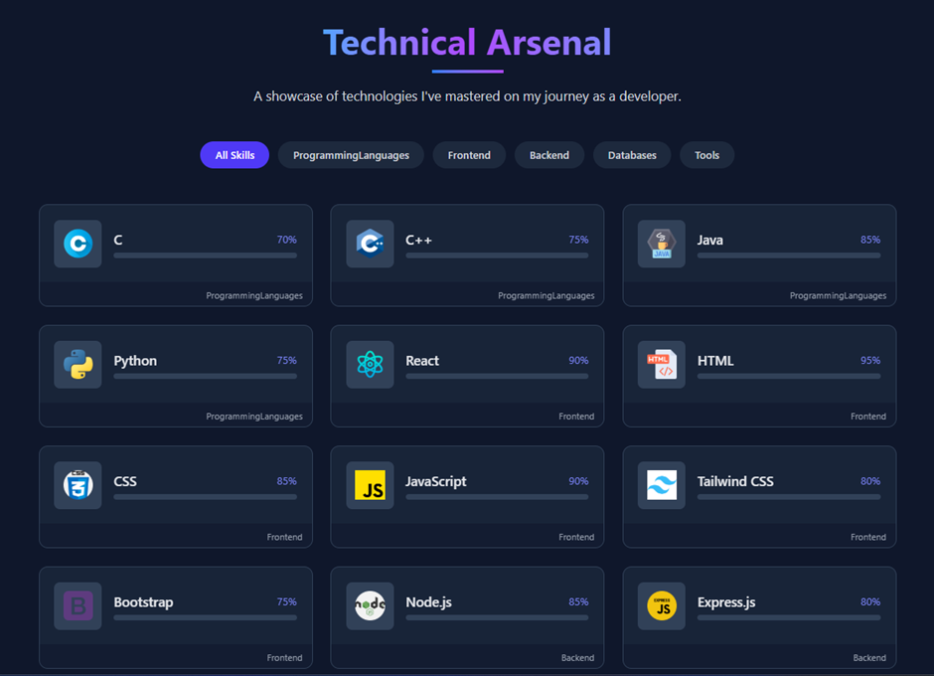
Skills
1
2
Group skills as per category
Programming languages (Python, Java, C++)
Tools & frameworks (Git, Docker, React, TensorFlow)
Soft skills (communication, teamwork)
Highlight the relevant skills
3
4
5
6
7
8
9
Notes:
Group skills by category for clarity. Recruiters often scan for specific tools.
Recruiters often scan candidate profiles for specific tools and technologies. Categorised skills help match your capabilities with job descriptions and ATS (Applicant Tracking System) filters.

Slide 10
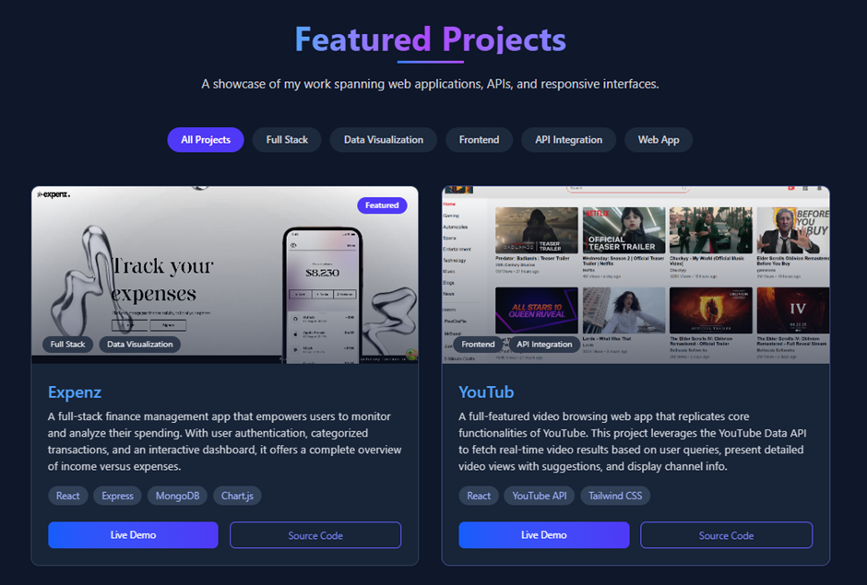
Project
1
2
Showcase your major academic and personal projects.
Include key headings for clarity.
Title & description
Technologies used
Role, challenges, outcomes
GitHub/demo links
3
4
5
6
7
8
9
Notes:
Projects show application of theory. Example: “Built ML model for sentiment analysis using Python & TensorFlow.”

Slide 11
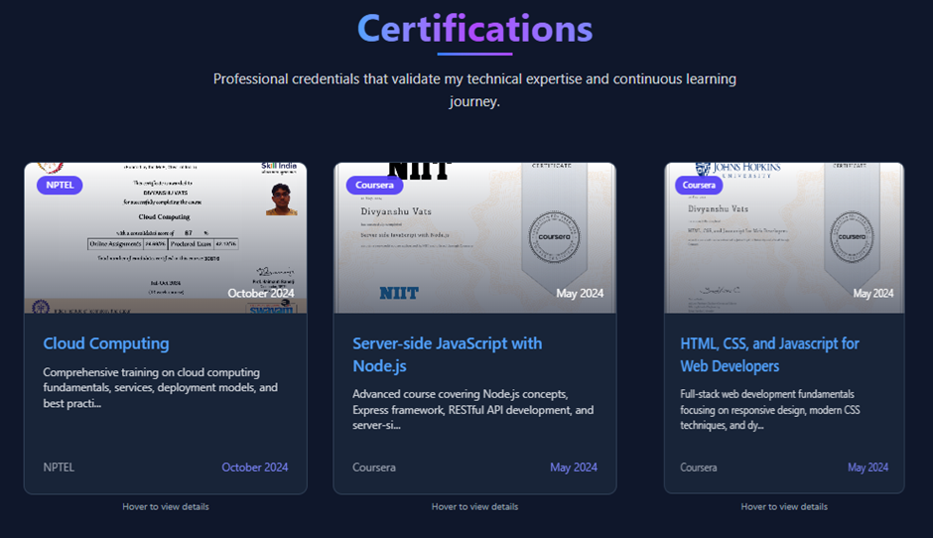
Certificates
1
2
Content:
Course name & issuing body
Relevant certifications (Data Science, Cybersecurity, Cloud)
Completion dates
3
4
5
6
7
8
9
Notes:
Certifications validate your initiative to learn beyond the classroom. They show commitment to continuous learning and help bridge gaps between academic curriculum and industry expectations.

Slide 12
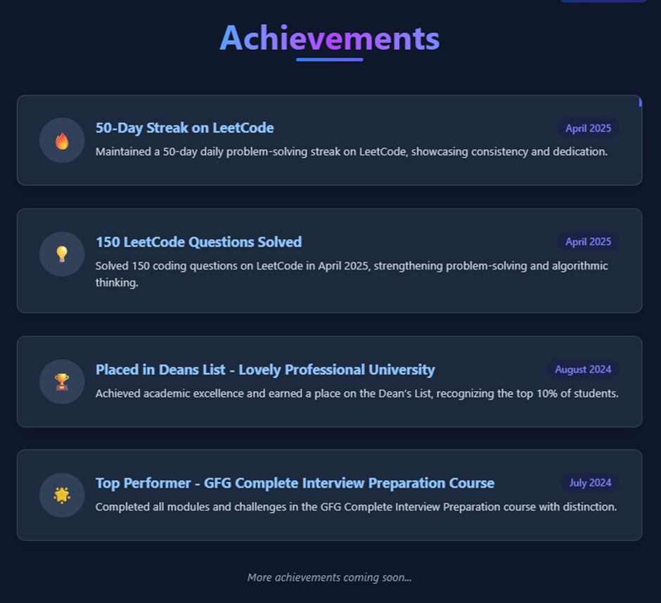
Achievements
1
2
3
Achievements reflect excellence and leadership.
Content:
Coding competitions, scholarships, and leadership roles
Dates & brief descriptions
4
5
6
7
8
9

Slide 13
10
Internships & Work Experience
Showcase your experience
Content:
Company name, role, duration
Key responsibilities & outcomes
Notes:
Internships show readiness for real‑world work. Example: “Developed APIs at XYZ startup, improving response time by 20%."

Slide 14
11
Competitive Programming / Hackathons
Add these with pics (if possible for extra edge)
Content:
Platforms: LeetCode, HackerRank, Kaggle
Rankings & event participation
Notes:
These experiences highlight analytical thinking and coding proficiency.

Slide 15
12
Research & Publications
Highlight your expertise with intensive knowledge
Content:
Titles, abstracts, co‑authors
Publication links
Notes:
Research signals depth and originality—valuable for AI, ML, and R&D roles.

Slide 16
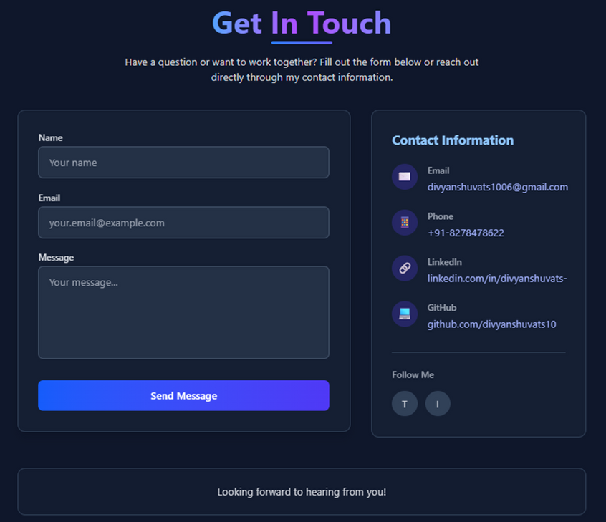
13
Contact Section
Easy access to your contact info ensures recruiter’s response
Content:
Email, LinkedIn, GitHub, portfolio website
Notes:
Professional contact info ensures recruiters can reach out easily.

Slide 17
14
Portfolio Hosting & Visibility
A digitally accessible portfolio increases visibility.
Platforms: GitHub Pages, Notion, personal website
Link portfolio in resume & LinkedIn
Notes:
Digital hosting increases visibility and shows tech‑savviness

Slide 18

Key Takeaways
Portfolio:
Resume + Proof of Work
Reflect:
Initiative, skills & growth
Essential:
For placements & career success

